Slide 1
Stock Market Predictions
Jeremy Randolph, Rohit Rao, Shishir Tewari, Harita Vellalath

Slide 2
Premise
We chose to use Machine Learning to build models to predict future economic performance using a variety of stock market health indicators.
Some of the factors we focused on:
Interest Rates
Unemployment Rates
GDP
CPI - Consumer Price Index
IPI - Industrial Production Index etc.
Why did we choose this topic?
It was one of the first topics that came to mind for us all and we knew it was something we could all relate to
Notes:
Harita

Slide 3
Our Data
Fred Economic Data - https://fred.stlouisfed.org/
ETL Overview
Converting quarterly and daily data to monthly
Data Cleanup
Notes:
Shishir

Slide 4
Exploring Our Data

Slide 5
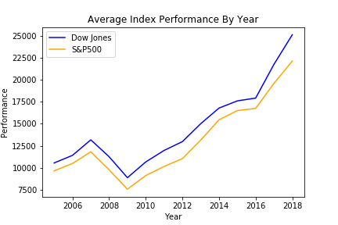
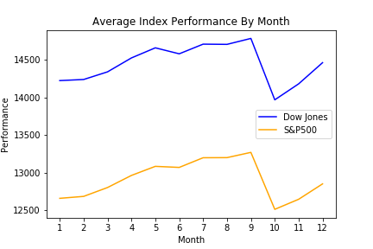
Average Index Performance By Year/ Month
Notes:
Shishir/Harita
Created a coupe visualizations displaying the average index performance by year and month
It shows that Dow Jones and S&P 500 go hand in hand
One index goes down the other goes down as well

Slide 6
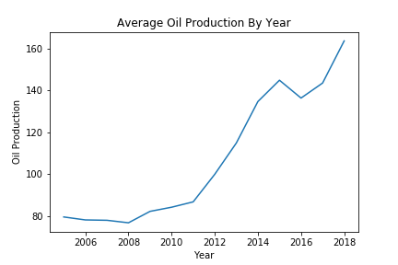
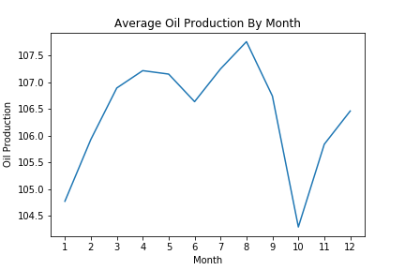
Average Oil Production By Year/Month
Notes:
Shishir/Harita

Slide 7
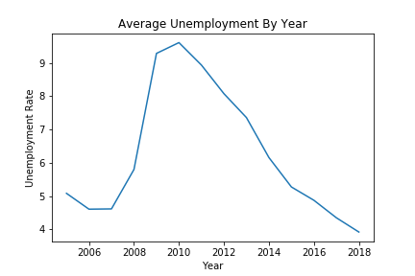
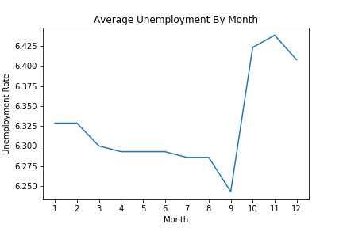
Average Unemployment By Year/Month
Notes:
Shishir/Harita

Slide 8
Machine Learning
Notes:
Rohit

Slide 9
Overview
Multivariate Linear Regression
Long Short-Term Memory (LSTM)
Notes:
Rohit

Slide 10
Multivariate Linear Regression
Used to measure impact of multiple independent variables (X-values) on a single dependent variable (Y-values)
Predicted Variable: Consumer Price Index (CPI)
Used to measure inflation
Process Overview
Split training & testing data
Fit training data to model
Make predictions
Evaluate accuracy of predictions using testing data
Residuals Plot
Notes:
Rohit
Model Coefficients measure of correlation

Slide 11
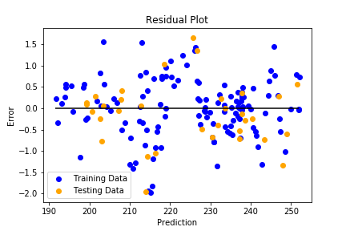
CPI Residuals Plot
Used to visualize accuracy of model by measuring error of predictions
Unable to model multiple predictor variables on a 2D plot
Results show predictions accurate within 2 points of the actual CPI index (Very accurate)
Tried to use Dow Jones/SP500 index performance as y-value, with much higher error
Notes:
Rohit
Model Coefficients measure of correlation

Slide 12
LSTM - Long Short-Term Memory
LSTM is a Recurrent Neural Network (RNN) used for making predictions based on time series data
We used it for both S&P500 and Dow Jones
We choose to use this type of neural network since we worked with time series data and thought it would work well
We also wanted to try and learn something new in the process
Notes:
Jeremy

Slide 13
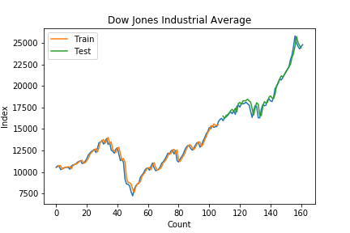
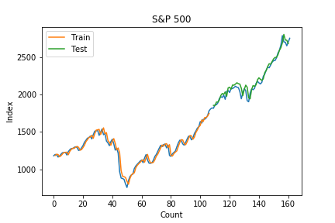
LSTM Visualizations
Notes:
Jeremy

Slide 14
Challenges
Finding Data Sources
Aggregating data by month
Stock Prices have multiple factors
Traditional Neural Networks were inaccurate
Learning new model LSTM
Notes:
Jeremy

Slide 15
Conclusion
We started with the idea of predicting something that is “unpredictable”
Used Multivariable linear regression and LSTM
We were able to produce visuals to represent the accuracy of our models
Notes:
It is not easy to predict
Stock market is unpredictable so it was interesting to try to predictive
We started with the idea of predicting something that we say to be unpredictable
We decided the models we were focusing in was multivariable linear regression and ltsm
After the challenges faced from the data collection to learning a different type of neural network
We were able to produce as much as we can in regards to predicting and have visuals with displaying results well

Slide 16
Questions?

